Slide 1
The solutions of Friedmann Universe
尺度因子$a(t)$随时间的演化 ，即宇宙膨胀历史！

Slide 2
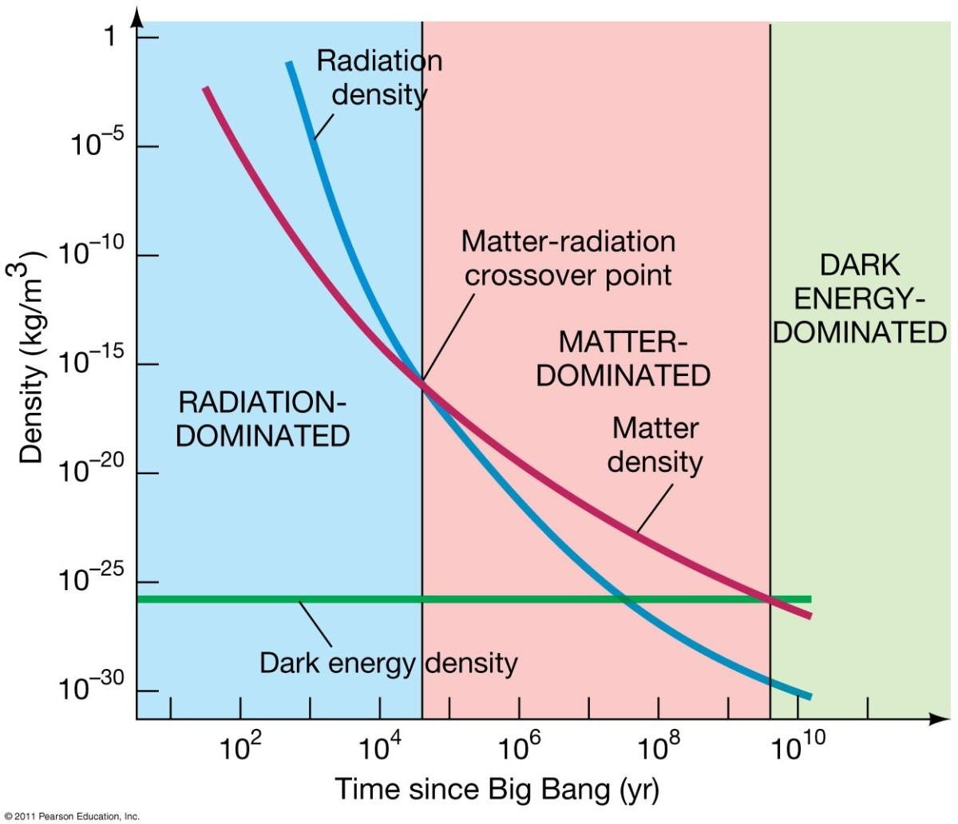



辐射主导转化为物质主导
观测得到：$Ω_{m}\sim 0.3≫Ω_{r}\sim 5×{10}^{−5}$，由于它们的演化规律为:
$$ρ_{m}\left(z\right)=ρ_{m0}{\left(1+z\right)}^{3}, ρ_{r}(z)=ρ_{r0}{(1+z)}^{4}$$
曾经必然存在某一时刻$zeq$物质-辐射相等
$1+z_{eq}=\frac{Ω_{m}}{Ω_{r}}$
$$zeq=3614$$
不同成分按照不同幂律随红移演化，必然有某些成分占主导的时期！

Slide 3
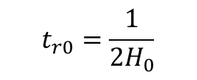
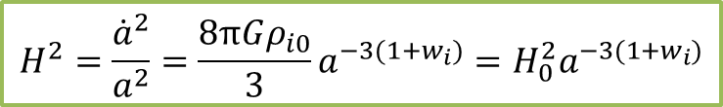

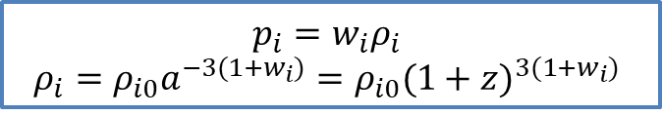

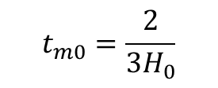
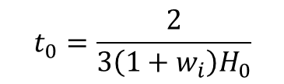

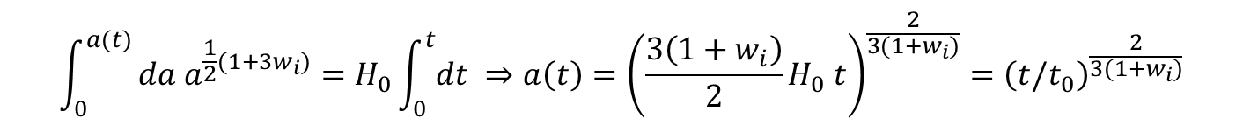
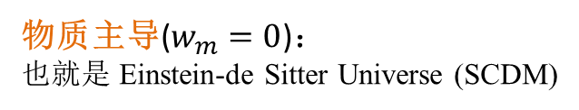
单一成分宇宙
1、对于物质、辐射，平坦宇宙中：
$$p_{i}=w_{i}ρ_{i}$$
$$ρ_{i}=ρ_{i0}a^{−3(1+w_{i})}=ρ_{i0}{(1+z)}^{3(1+w_{i})}$$
$$H^{2}=\frac{{\dot{a}}^{2}}{a^{2}}=\frac{8πGρ_{i0}}{3}a^{−3(1+w_{i})}=H_{0}^{2}a^{−3(1+w_{i})}$$
$$\int_{0}^{a(t)}{da a^{\frac{1}{2}(1+3w_{i})}}=H_{0}\int_{0}^{t}{dt }⇒a\left(t\right)={\left(\frac{3\left(1+w_{i}\right)}{2}H_{0} t\right)}^{\frac{2}{3(1+w_{i})}}={\left(t/t_{0}\right)}^{\frac{2}{3(1+w_{i})}}$$
$$t_{0}=\frac{2}{3\left(1+w_{i}\right)H_{0}}$$
得到单一成分宇宙的年龄：
辐射主导($w_{r}=\frac{1}{3}$)：
物质主导($w_{m}=0$)：
也就是 Einstein-de Sitter Universe (SCDM)
$$a_{r}\left(t\right)={\left(t/t_{r0}\right)}^{\frac{1}{2}},$$
$$t_{r0}=\frac{1}{2H_{0}}$$
$$a_{r}\left(t\right)={\left(t/t_{m0}\right)}^{\frac{2}{3}},$$
$$t_{m0}=\frac{2}{3H_{0}}$$
减速膨胀的宇宙

Slide 4
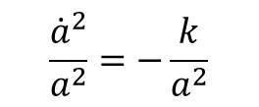

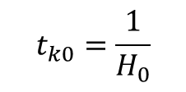
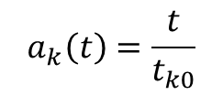

单一成分宇宙
2、曲率主导的宇宙(The Empty Universe)：
Also referred to as the Milne model
$$Ω_{r}=Ω_{m}=Ω_{Λ}=0, { Ω}_{k}=1$$
$$\frac{{\dot{a}}^{2}}{a^{2}}=−\frac{k}{a^{2}}$$
$$a_{k}\left(t\right)=\frac{t}{t_{k0}}$$
$$t_{k0}=\frac{1}{H_{0}}$$
均匀膨胀解
$$H_{0}^{2}=−k⇒k<0 (Open universe)$$
3、暗能量主导的宇宙(de Sitter Universe)：
在后续de Sitter Universe 的求解中，作为曲率为0的特例讨论

Slide 5
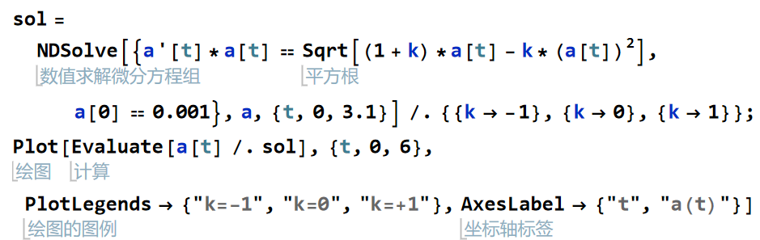
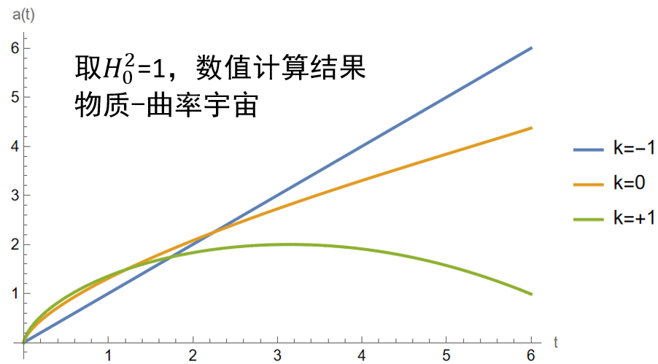
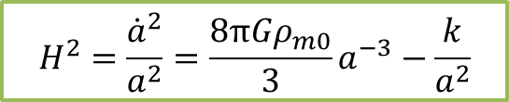

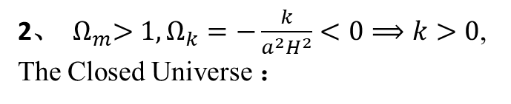
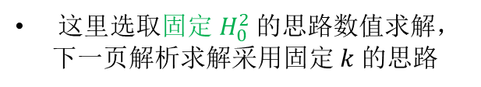
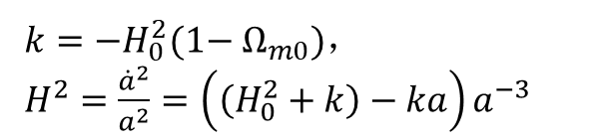
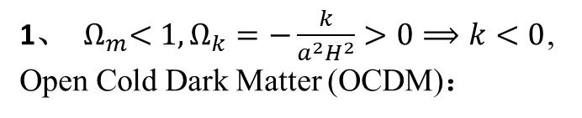
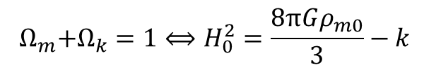
物质-曲率 宇宙
$$H^{2}=\frac{{\dot{a}}^{2}}{a^{2}}=\frac{8πGρ_{m0}}{3}a^{−3}−\frac{k}{a^{2}}$$
$$Ω_{r}=Ω_{Λ}=0,$$
$${ Ω}_{m}+Ω_{k}=1⟺H_{0}^{2}=\frac{8πGρ_{m0}}{3}−k$$
$H_{0}^{2},ρ_{m0}, k$三个变量，固定$H_{0}^{2}$则其余两者一一对应
$这里$选取固定$H_{0}^{2}$的思路数值求解，下一页解析求解采用固定$k$的思路
1、 ${ Ω}_{m}<1,Ω_{k}=−\frac{k}{a^{2}H^{2}}>0⟹k<0$, Open Cold Dark Matter (OCDM)：
$k=−H_{0}^{2}(1−{ Ω}_{m0})$，
$H^{2}=\frac{{\dot{a}}^{2}}{a^{2}}=\left(\left(H_{0}^{2}+k\right)−ka\right)a^{−3}$
2、 ${ Ω}_{m}>1,Ω_{k}=−\frac{k}{a^{2}H^{2}}<0⟹k>0$, The Closed Universe ：
公式不变，取不同的k

Slide 6
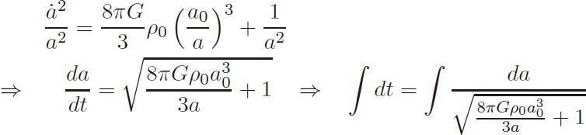





OCDM 解析求解
_{e}η _{+ e}−η
_{e}η _{− e}−η
coshη = , sinhη =
2 2
Ω
Ω
t → ^{M} e^{η}
a(t) = a₀ ^{M} (coshη −1);
4H (1−Ω
₎3/ 2
2(1−Ω )
0
M
M
当t → ∞
Ω_{M}
(sinhη −η)
Ω_{M}
₎1/ 2 _{H t}
t =
₎3/ 2
a(t) → a
e^{η} → (1− Ω
2H (1−Ω
⁰ 4(1−Ω )
M
0
0
M
M
expand forever!!!

Slide 7
The Closed Universe 解析求解
Ω_{R} = Ω_{Λ} = 0, Ω_{M} + Ω_{k} = 1, Ω_{M} > 1, Ω_{k}< 0, k = 1
Ω_{M}
a(t) = a
(cosη −1)
0
2(1−Ω )
M
Ω_{M}
t =
₋₁₎3/ 2
(η − sinη)
2H (Ω
0
M
a(t) starts from 0, and reaches a maximum value at η=π
Ω_{M}
a = a
0 _{Ω}
max
−1
M
The age of the universe is
1
πΩ_{M}
t =
₋₁₎3/ 2
max
2H (Ω
0
M

Slide 8
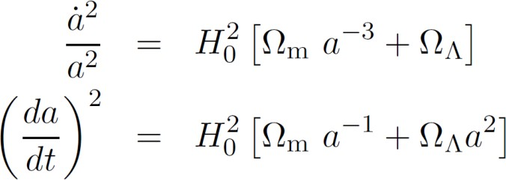
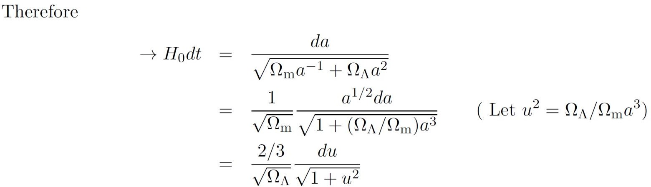
宇宙常数-物质 宇宙
For a Universe with both matter and cosmological constant, we have

Slide 9
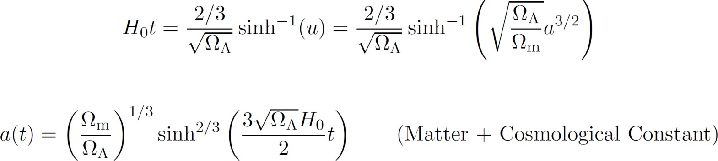
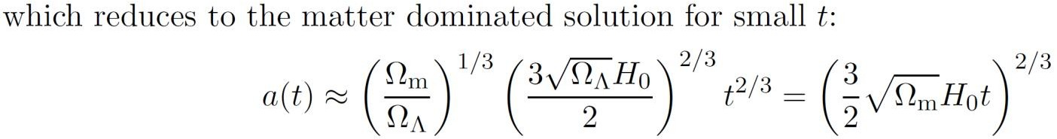
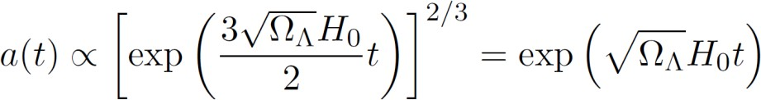

Slide 10

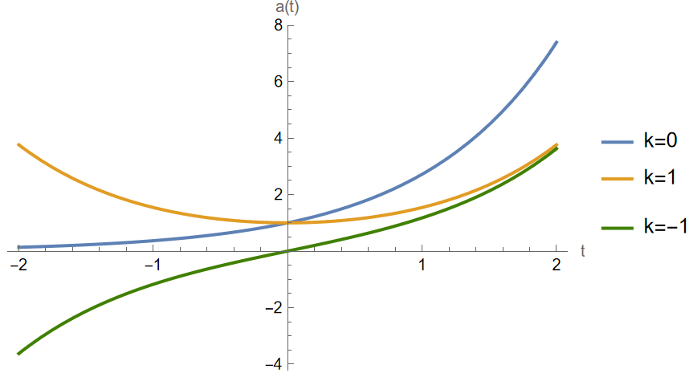
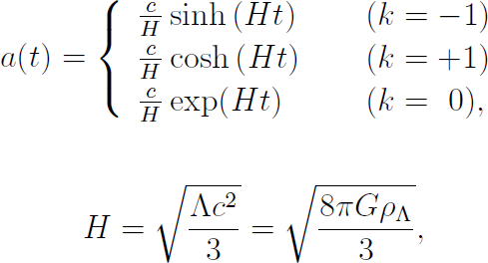

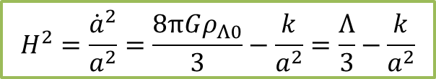
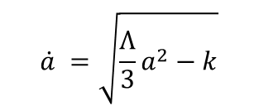
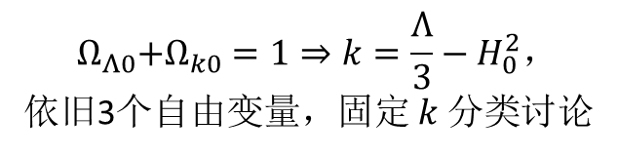
de Sitter Universe (Vacuum-dominated)
宇宙常数-曲率 宇宙
$${ Ω}_{Λ0}+Ω_{k0}=1⇒k=\frac{Λ}{3}−H_{0}^{2}，$$
依旧3个自由变量，固定$k$分类讨论
$$H^{2}=\frac{{\dot{a}}^{2}}{a^{2}}=\frac{8πGρ_{Λ0}}{3}−\frac{k}{a^{2}}=\frac{Λ}{3}−\frac{k}{a^{2}}$$
$$\dot{a} =\sqrt{\frac{Λ}{3}a^{2}−k}$$
取$\frac{Λ}{3}=1$绘制

Slide 11
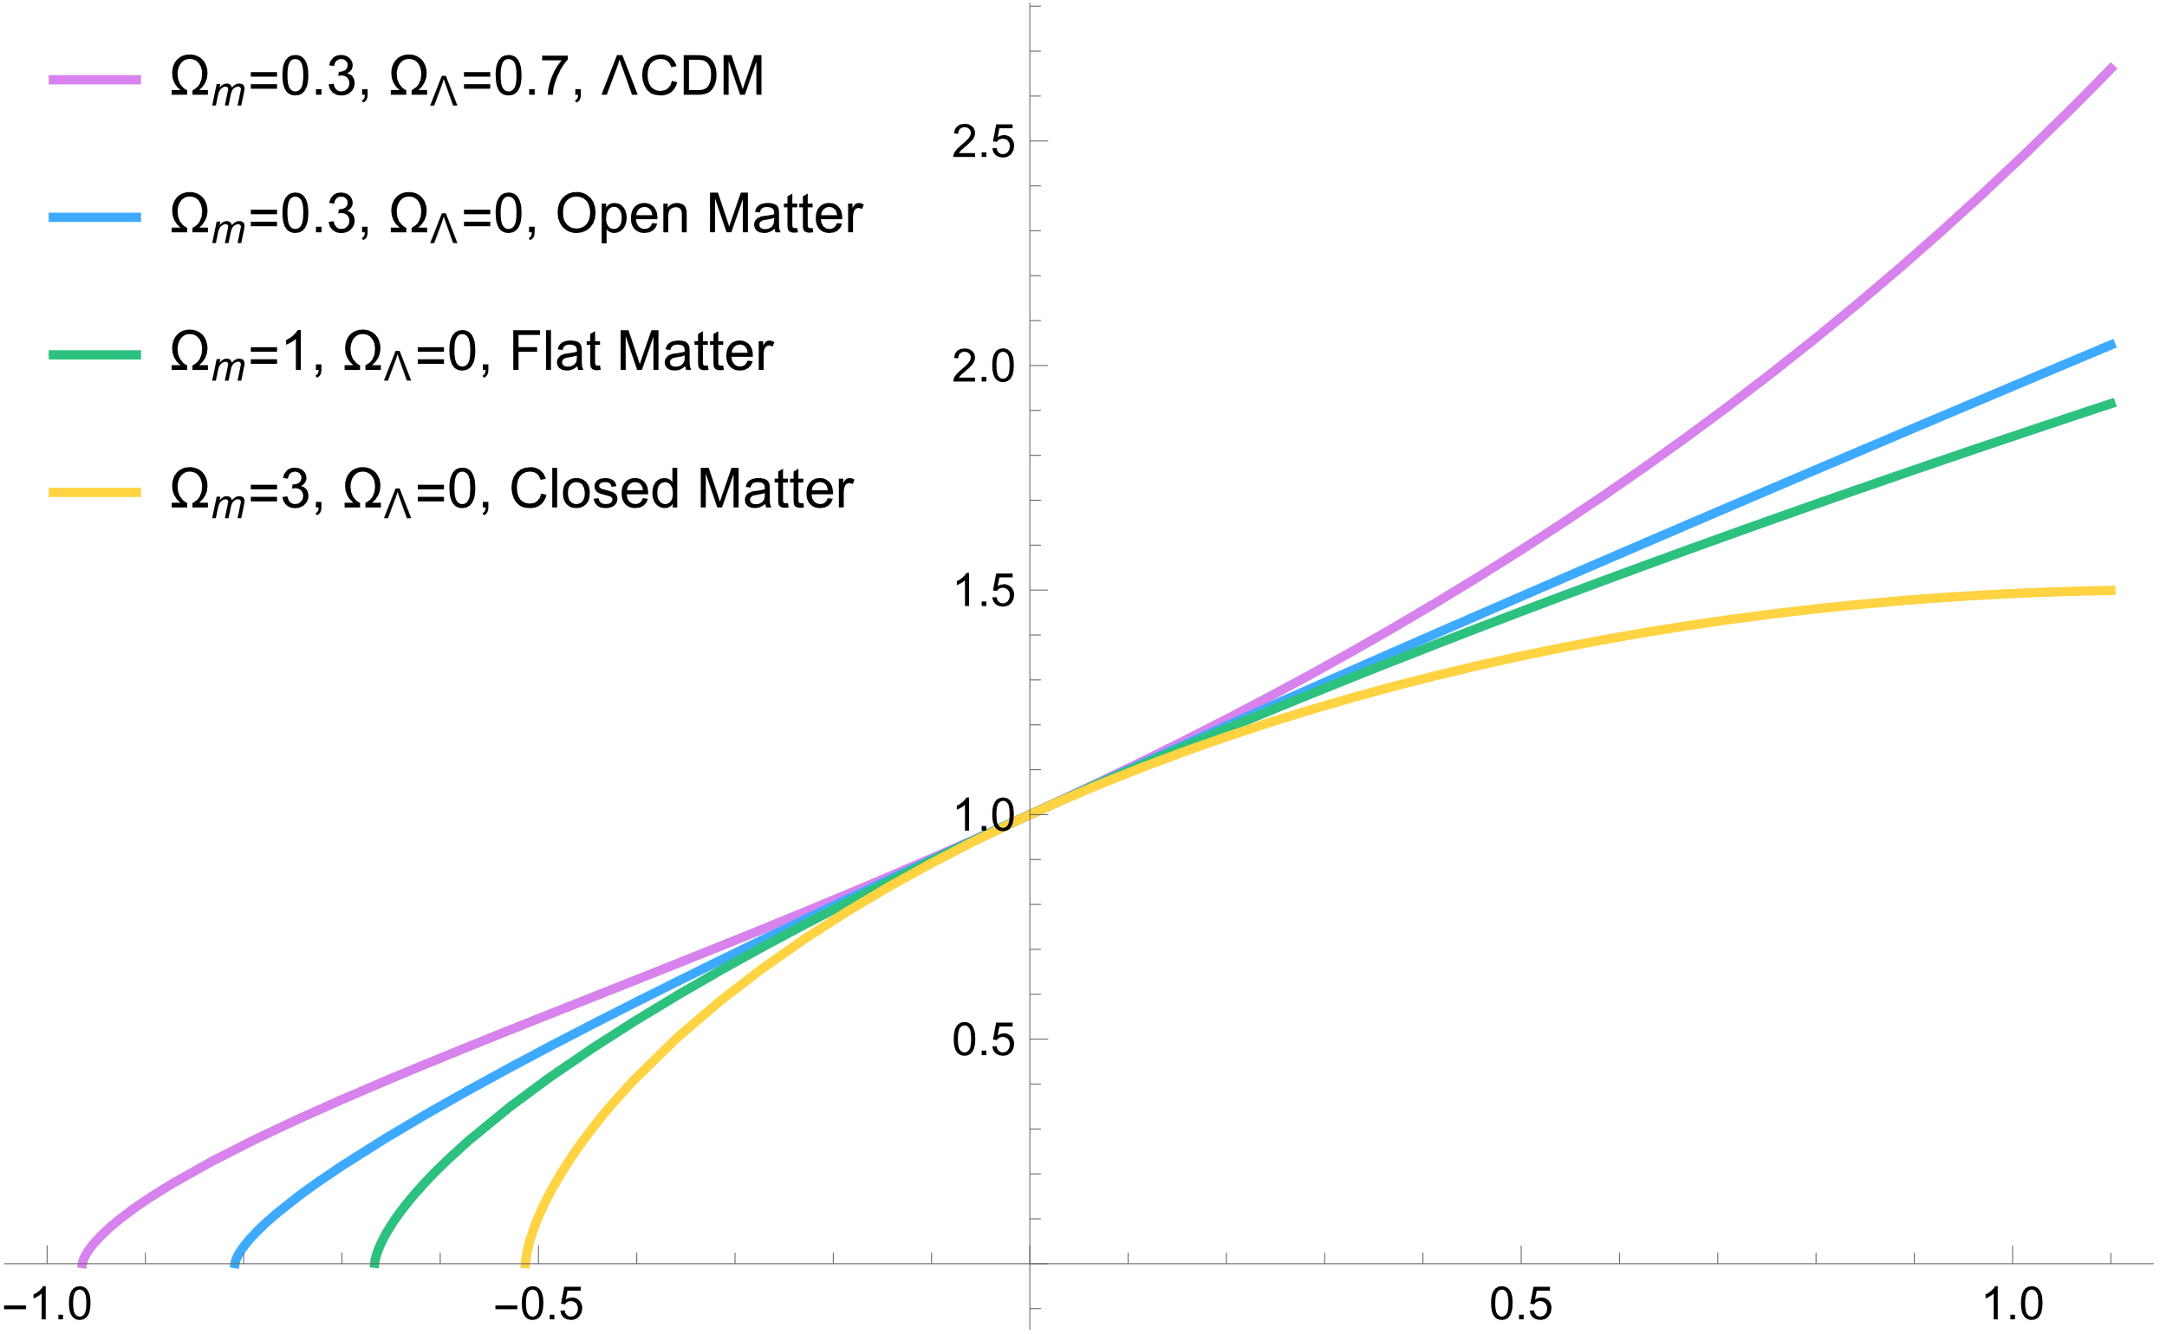
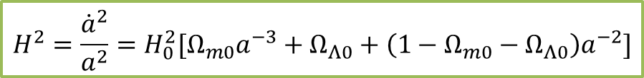

ΛCDM Universe
$$H^{2}=\frac{{\dot{a}}^{2}}{a^{2}}=H_{0}^{2}[Ω_{m0}a^{−3}+Ω_{Λ0}+\left(1−Ω_{m0}−Ω_{Λ0}\right)a^{−2}]$$
忽略辐射成分，固定$H_{0}^{2}$
$$\dot{a}\sqrt{a}=H_{0}{\left[Ω_{m0}+\left(1−Ω_{m0}−Ω_{Λ0}\right)a+Ω_{Λ0}a^{3}\right]}^{1/2}$$
容易直接数值求解

